Slide 1
Portfolio
App Module
Home
Banking Module
Mutual Fund Module
Stocks Module
Account Summary
Fund Overview
Stock Summary
Transaction History
Investment Calculator
Market Trends
Shared Module
Header
Footer
Profile
Core Module
Logger
Caching
Auth Service

Slide 2
Monolith Architecture
Channels
User
Application
Banking Module
Mutual Fund Module
Header
Account Summary
Fund Overview
Footer
Transaction History
Investment Calculator
Logger
Caching
Stocks Module
Reporting Module
Stock Summary
Daily Reports
Profile
Market Trends
Company Reports
Auth Service

Slide 3
Micro Frontend Architecture
Shell
Working Area
Banking Module
Stocks Module
Account Summary
Stock Summary
Configuration
Transaction History
Market Trends
Events
Reporting Module
Mutual Fund Module
Daily Reports
Fund Overview
State
Company Reports
Investment Calculator
Core Services
User
Header
Footer
Logger
Auth Service
Caching
Profile
Themes

Slide 4
Simple Chatbots using Pre-trained LLM
Chatbots with custom data (RAG))
Copilot that works side by side
Autonomous AI Agents

Slide 5
Components of AI Agents – Conceptual View
Agent
Sensors
Environment
Control Centre
Digital
LLM
User Input
Tools
Learnings
Physical
Memory
Decision
Effectors

Slide 6

Distributed Multi Agent System
Financial Agents
Accounting Agent
Accounting Agent
Credit Agent
Payment Agent
Policy Agent
Approval Agent
Plugins
Master Agent
Memory
Platform Core Services
User Input
Azure Service Bus
LLM
Supply Chain Agents
Invoice Agent
Forecasting Agent
Transportation Agent
Quality Agent
Approval Agent
Planner Agent
Domain Services
Credit Service
Financial
Services
Supply Chain
Services
Accounting
Payment
Invoice
Quality
Credit
Policy
Forecasting
Transportation
AI Core Services
RAG Engine
RAG
Engine
Agent
Registry
Plugin Libraries
Accounting
Accounting
Credit
Credit
Payment Service
Digital Core
ITSM
Enterprise Apps
DMS

Slide 7
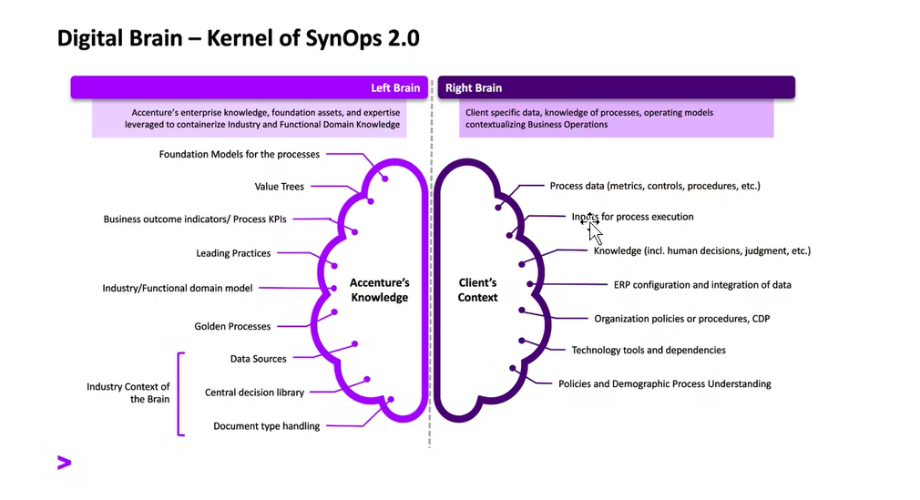

Slide 8
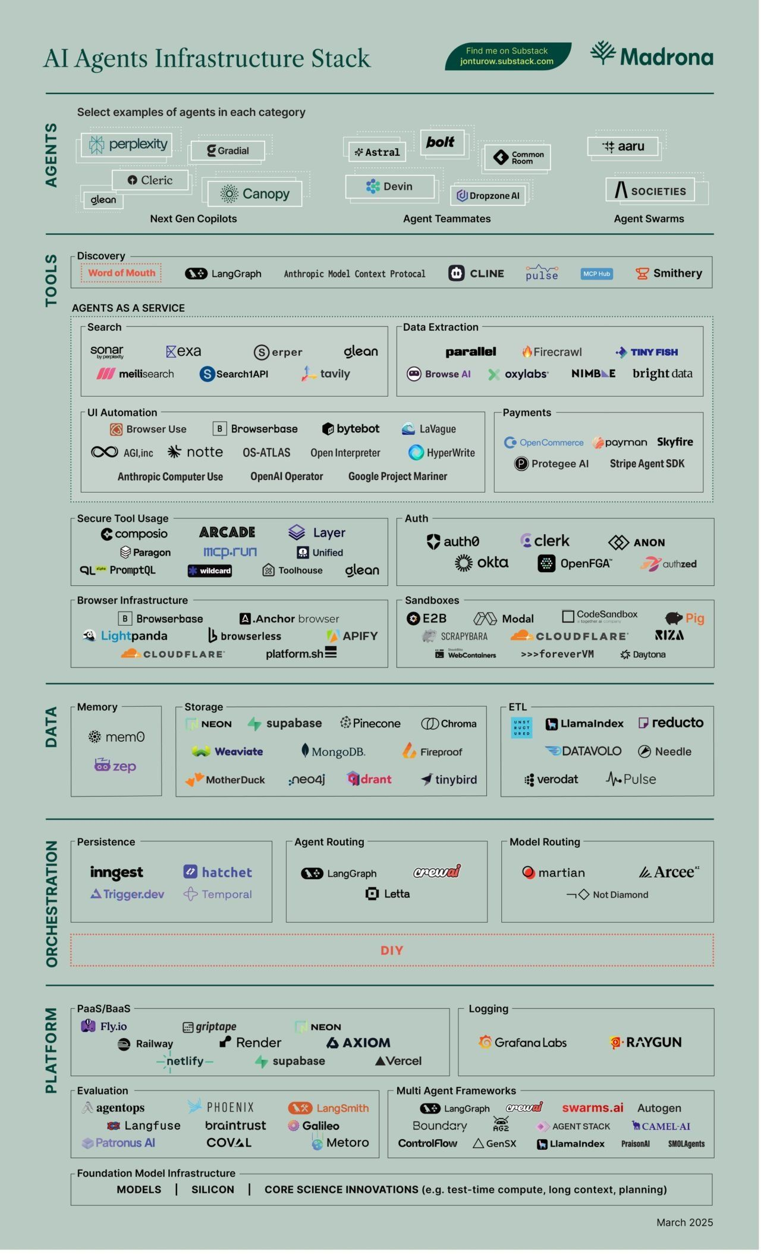

Slide 9
Data Transformation
Without Gateway
With Gateway
System 1
System 2
System 3
System 1
System 2
System 3
TCP
XML
HTTP
JSON
MSMQ
Excel
TCP
XML
HTTP
JSON
MSMQ
Excel
Gateway
Client App
Client App
In this setup a client application needs to perform tasks to talk to all 3 systems -
Protocol (TCP /HTTP/MSMQ)
Data Format( XML/JSON/CSV/EXCEL/Proprietary)
Transformation( Convert in format that app can understand)
Aggregation (Relate data from multiple sources into one entity)
Updates (Perform above operation in reverse while updating data)
In this setup major work is left to Gateway which performs the heavy lifting, there by allowing Client App to focus on more business oriented work. The gateway perform tasks to talk to all 3 systems -
Protocol (TCP /HTTP/MSMQ)
Data Format( XML/JSON/CSV/EXCEL/Proprietary)
Transformation( Convert in format that app can understand)
Aggregation (Relate data from multiple sources into one entity)
Updates (Perform above operation in reverse while updating data)

Slide 10
Distributed Multi Agent System
User Input
Agent 2
Agent 1
Decision
Effectors
Connectors
Ingestion

Slide 11
AI Agents & MCP Registry
Without MCP Registry
With MCP Registry
MCP Server
MCP Server
MCP Server
MCP Server
MCP Server
MCP Server
MCP Server
MCP Server
MCP Registry
Agent
Agent
Agent
Agent
Agent
Agent
Agent
Agent
P2P , No Governance, Fragmented Discovery
No RBAC
Registry Imposes RBAC, Governance, Authorization, Policy

Slide 12
Microsoft Agent Identity Platform
Authentication &Authorization
Token System
SDK Integration
Agent Registry & Management
Governance & Compliance

Slide 13
